Slide 1
Crypto 101
by Victor Azzam

Slide 2


Slide 3


Slide 4


Slide 5


Slide 6


Slide 7
Cryptography?
The study of hiding information in plain sight, for example:
• AES
• RSA
• Blowfish
Includes hashing such as MD5, SHA, etc
Not the same as encoding! (base64, hex, etc)
Requires years of learning and experience in high level mathematics.
Not an easy pill to swallow overnight, study more!

Slide 8


Slide 9
Types
1) Symmetric Key
• Uses 1 key for encryption and decryption
• AES, RC4 (remember WEP? yeah neither do I)
2) Asymmetric Key
• Uses 2 keys, public (encrypt) and private (decrypt)
• RSA, DSA, ECDH
3) Hashing Function
• Irreversible mathematical metaphysical spiritual
• MD5, SHA256, Argon (recommended)

Slide 10
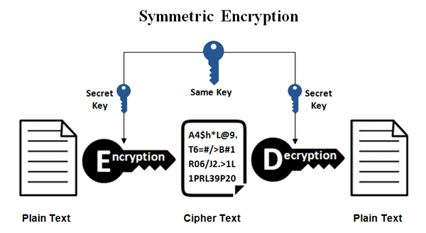
Symmetric
The sender and receiver use one key to hide and reveal the secret message.

Slide 11
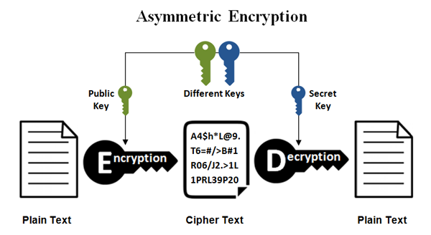
Asymmetric
The sender uses the receiver’s public key to hide the secret message, and the receiver reads the message with their private key.

Slide 12
Hashing
my_Super_s3cure_p4ssw0rd
af6c52698f8703ebd755a531a50723e6bc41fdc47c199f3a1b9e5511c8358850
✔︎
✘

Slide 13
Encoding
It is not the same as encryption, not secure!
Different ways of representing the same thing.
Text
Caesar (by 6)
Rot13
Base64
Morse code
play your best move
vrge euax hkyz subk
cynl lbhe orfg zbir
cGxheSB5b3VyIGJlc3QgbW92ZQ==
.--. .-.. .- -.-- -.-- --- ..- .-. -... . ... - -- --- ...- .
A simple online conversion tool will decode all of them.

Slide 14


Slide 15
Attacks
Cryptanalysis is the study of breaking cryptography.
• Brute force
• Dictionary
• Cold boot
Ways to defend against attacks:
• Layers! More is better
• Full disk encryption
• Don’t leave your devices unsupervised
It is recommended that you use independently audited, open-source software for messaging, for example:
Wire instead of Telegram, Signal instead of WhatsApp

Slide 16


Slide 17
References
https://www.garykessler.net/library/crypto.html
https://en.wikipedia.org/wiki/Encryption
https://en.wikipedia.org/wiki/Cryptanalysis
https://www.ssl2buy.com/wiki/symmetric-vs-asymmetric-encryption-what-are-differences
https://learncryptography.com/cryptanalysis
https://wire.com
https://signal.org

